Slide 1
Resources and Resource Access Control
how resource contention affects the execution behavior and schedulability of jobs, how various resource access-control protocols work to reduce the undesirable effect of resource contention, and how well these protocols succeed in achieving this goal. We focus on priority-driven systems. Clock-driven systems do not have these problems as we can avoid resource contention among jobs by scheduling them according to a cyclic schedule that keeps jobs’ resource accesses serialized.

Slide 2
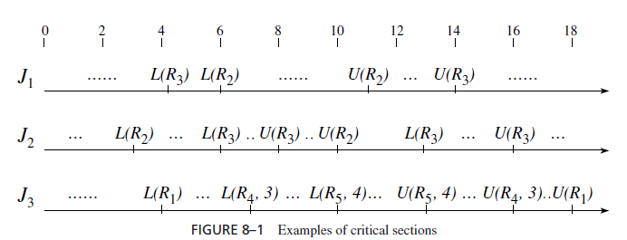
Critical Section… Lock and Unlock

Slide 3
Resource conflict and blocking
Two jobs conflict with one another, or have a resource conflict, if some of the resources they require are of the same type. The jobs contend for a resource when one job requests a resource that the other job already has. The scheduler always denies a request if there are not enough free units of the resource to satisfy the request. Sometimes, a scheduler may deny a request even when the requested resource units are free in order to prevent some undesirable execution behavior. When the scheduler does not grant ηi units of resource Ri to the job requesting them, the lock request L(Ri, ηi ) of the job fails (or is denied). When its lock request fails, the job is blocked and loses the processor. A blocked job is removed from the ready job queue. It stays blocked until the scheduler grants it ηi units of Ri for which the job is waiting. At that time, the job becomes unblocked, is moved backed to the ready job queue, and executes when it is scheduled.

Slide 4
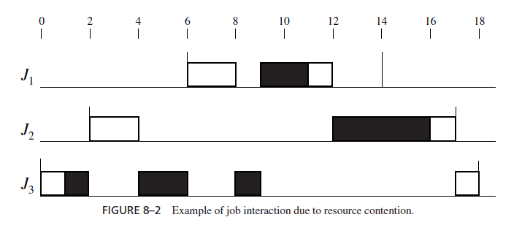
Effect of resource contentions. There are three jobs, J1, J2, and J3, whose feasible intervals are (6, 14], (2, 17] and (0, 18], respectively. All three jobs require the resource R, (Black). In particular, the critical sections in these jobs are [R; 2], [R; 4], and [R; 4], respectively. The black boxes in Figure show when the jobs are in their critical sections.(EDF scheduling)

Slide 5
Priority inversion timing anomalies and deadlock;
priority inversion can occur when the execution of some jobs or portions of jobs is nonpreemptable. Resource contentions among jobs can also cause priority inversion. Because resources are allocated to jobs on a nonpreemptive basis, a higher-priority job can be blocked by a lower-priority job if the jobs conflict, even when the execution of both jobs is preemptable. In the prior example , the lowest priority job J3 first blocks J2 and then blocks J1 while it holds the resource R. As a result, priority inversion occurs in intervals (4, 6] and (8, 9].

Slide 6
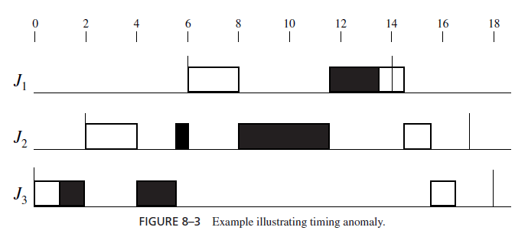
When priority inversion occurs, Timing anomalies invariably follow. The 3 jobs are the same as those earlier except that the critical section in J3 is [R; 2.5]. In other words, the execution time of the critical section in J3 is shortened by 1.5.our intuition might tell us that as a consequence of this reduction in J3’s execution time, all jobs should complete sooner. Indeed, this reduction does allow jobs J2 and J3 to complete sooner. Unfortunately, rather than meeting its deadline at 14, J1 misses its deadline because it does not complete until 14.5 .Feasible Interval J1 (6, 14], J2(2, 17] and J3 (0, 18]

Slide 7
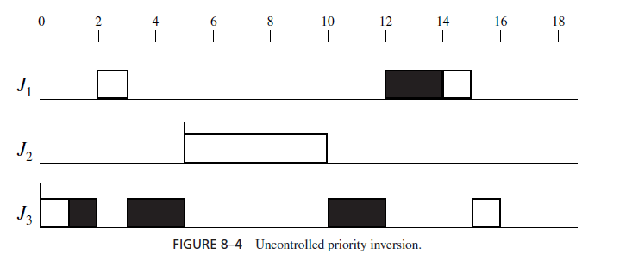
Uncontrolled priroty inversion:Here, jobs J1 and J3 have the highest priority and lowest priority, respectively. At time 0, J3 becomes ready and executes. It acquires the resource R shortly afterwards and continues to execute. After R is allocated to J3, J1 becomes ready. It preempts J3 and executes until it requests resource R at time 3. Because the resource is in use, J1 becomes blocked, and a priority inversion begins. While J3 is holding the resource and executes, a job J2 with a priority higher than J3 but lower than J1 is released. Moreover, J2 does not require the resource R. This job preempts J3 and executes to completion. Thus, J2 lengthens the duration of this priority inversion. In this situation, the priority inversion is said to be uncontrolled .

Slide 8
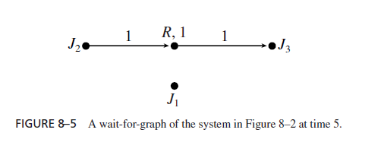
Wait- for –Graph The resource R is allocated to J3 and J2 is waiting for the resource. Thepath from J2 to J3 indicates that J2 is directly blocked by J3. Later, J1 will also be directly blocked by J3 when it requests and is denied the resource, and the wait-for graph of the system will have an additional edge from J1 to R. Since there is only one resource, deadlock can never occur.

Slide 9
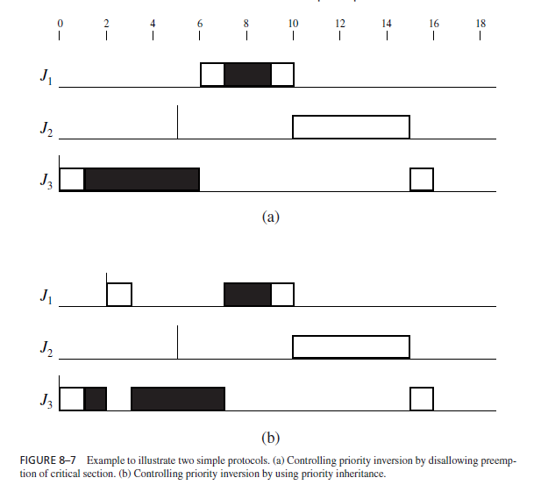
Controlling priority inversion by disallowing preemption of critical section non preemptive critical section(NPCS) and priority inheritence

Slide 10
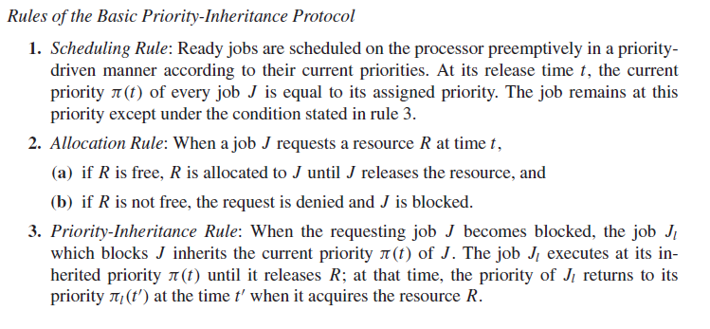
Rules of Priority inheritance Protocol

Slide 11
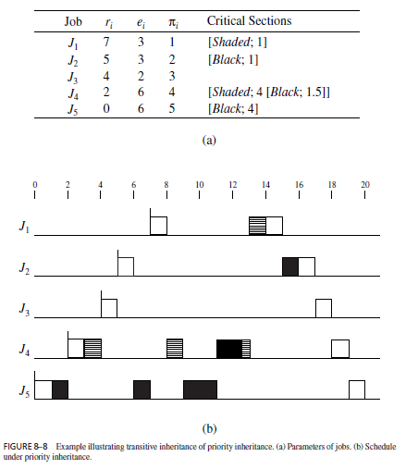

Slide 12
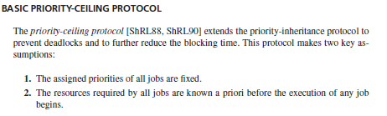
Priority ceiling Protocol

Slide 13
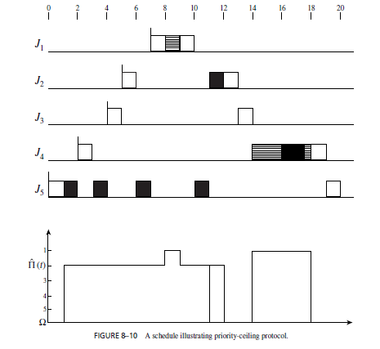

Slide 14
Differences between the Priority-Inheritance and Priority-Ceiling Protocols
A fundamental difference between the priority-inheritance and priority-ceiling protocols is that the former is greedy while the latter is not. You recall that the allocation rule (i.e., rule 2) of the priority-inheritance protocol lets the requesting job have a resource whenever the resource is free. In contrast, according to the allocation rule of the priority-ceiling protocol, a job may be denied its requested resource even when the resource is free at the time. (This is what happens to J4 at time 3 in the above example.)

Slide 15
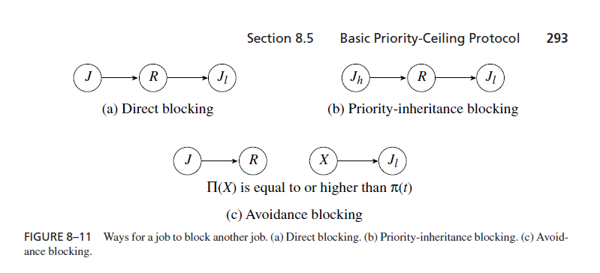
Job blocking
The requesting job J is blocked by a lower-priority job Jl when J requests a resource R that is free at the time. The reason is that Jl holds another resource X whose priority ceiling is equal to or higher than J ’s priority π(t).

Slide 16
There are three jobs: J1, J2, and J3 with priorities 1, 2, and 3, respectively. Their release times are 3.5, 1, and 0 and their critical sections are [Dotted; 1.5], [Black; 2 [Shaded; 0.7]], and [Shaded; 4.2 [Black; 2.3]], respectively. In this schedule, the intervals during which the jobs are in their critical sections are shown as the dotted box

Slide 17
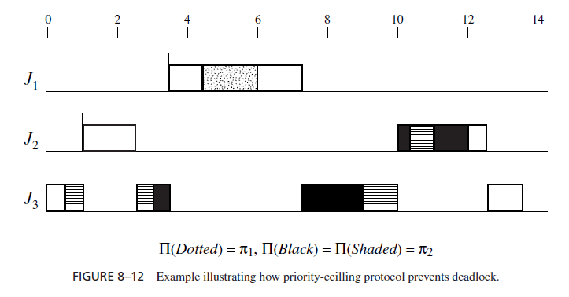
Avoidance of Deadlock using priority ceiling protocol

Slide 18
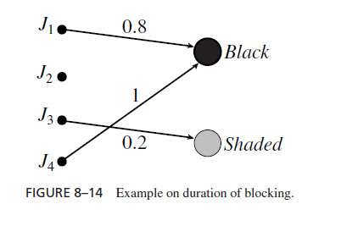
Blocking Time We see that J1 can be directed blocked by J4 for 1 unit of time. The blocking time b1(rc) of J1 is clearly one. Although J2 and J3 do not require the resource Black, they can be priority-inheritance blocked by J4 since J4 can inherit priority π1. Hence,the blocking times b2(rc) and b3(rc) are also one.

Slide 19
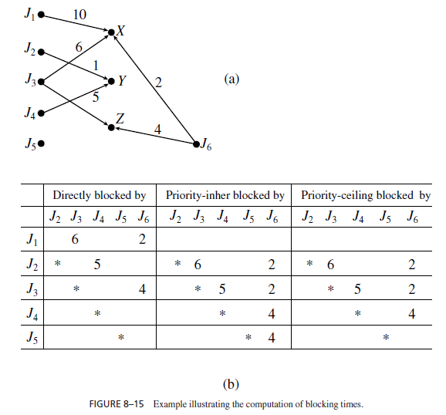
Computation of blocking time

Slide 20
STACK-BASED, PRIORITY-CEILING (CEILING-PRIORITY) PROTOCOL
we have assumed that each job has its own run-time stack. Sometimes, especially in systems where the number of jobs is large, it may be necessary for the jobs to share a common run-time stack, in order to reduce overall memory demand. if there are 10 jobs at each of 10 priority levels, the storage saving is 90 %. Space in the (shared) stack is allocated to jobs contiguously in the last-in-first-out manner. When a job J executes, its stack space is on the top of the stack. The space is freed when the job completes. When J is preempted, the preempting job has the stack space above J ’s. J can resume execution only after all the jobs holding stack space above its space complete, free their stack spaces, and leave J ’s stack space on the top of the stack again.

Slide 21
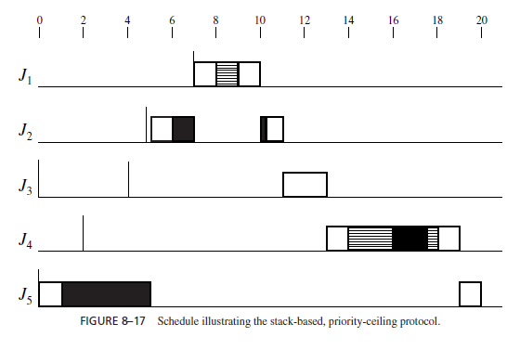

Slide 22
Preemption-Ceiling Protocols
In principle, the priority-ceiling protocol can be used in a dynamic-priority system. However, the high overhead due to the updates of priority ceilings of resources upon the releases of new jobs makes it unattractive. The preemption-ceiling protocol is a better alternative. The protocol is motived by the observation that the potential for a job to preempt other jobs depends not only on its priority but also on its release time. Therefore, rather than than working with priorities of jobs, the preemption-ceiling protocol assigns each job a preemption level based on its priority and release time: the higher the preemption level of a job, the larger the possibility of its preempting other jobs. So, a job that has a higher priority and later release time should have a higher preemption level. For example, the preemption levels of jobs in a deadline-driven system can be assigned on the basis of their relative deadlines: the shorter the deadline, the higher the preemption level.

Slide 23
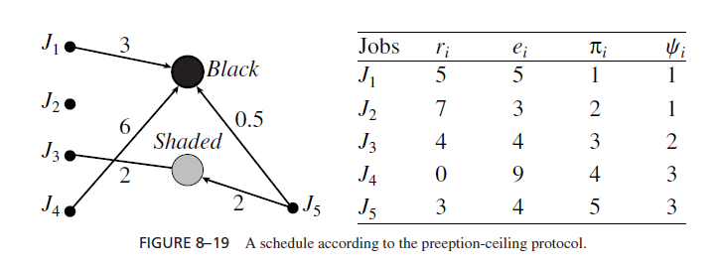
We note that J1, the job with the highest priority, has a later release time than J3, J4, and J5. Hence, J1 should have a higher preemption level than these three jobs. However, it is never possible for J1 to preempt J2 because J1 has an earlier release time, and it is never possible for J2 to preempt J1, because J2 has a lower priority. We therefore give these two jobs the same preemption level. Similarly, J3 should have a higher preemption level than J4 and J5, and we can give J4 and J5 the same preemption level. In summary, we can assign ψi for i = 1, 2, 3, 4, and 5 the values 1, 1, 2, 3, and 3, respectively; Validity Condition: If πi is higher than πk and ri > rk , then ψi is higher than ψk .

Slide 24
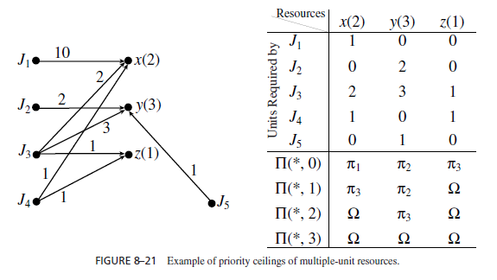
CONTROLLING ACCESSES TO MULTIPLE-UNIT RESOURCES
Priority (Preemption) Ceilings of Multiple-Unit Resources
The resource requirement graph gives the numbers of units of the resources X, Y, and Z required by the five jobs that are indexed in decreasing order of their priorities. The table below the graph gives the priority ceilings of each resource for different numbers of free resource units. For example, there are 2 units of X. When 1 unit of X is used, only J3 is directly blocked. Therefore, (X, 1) is π3. J1 is also directly blocked when both units of X are in use. For this reason, (X, 0) is π1, the higher priority between π1 and π3. When both units of X are free, the ceiling of the resource is . Similarly, since J2, J3, and J5 require 2, 3, and 1 unit of Y, which has 3 units, (Y, 0), (Y, 1), and (Y, 2) are equal to π2, π2, and π3, respectively. Suppose that at time t , 1 unit of each of X, Y, and Z is free. The priority ceilings of the resources are π3, π2, and , respectively, and the priority ceiling of the system is π2.

